Slide 1



LEAFVIVE
LeafVIVE
Detecting Disease. Protecting Green!

Slide 2



Who we are
Name of your Venture: LeafVIVE
Place your venture logo here
Why ?
Explain why do you want to pursue this Business Idea.
Sustainability & Leaf Security
Growing AgriTech Market
Financial Opportunity
Solving a Real-World Problem
AI & Technology Innovation
What ?
Provide a brief on what does your venture do.
LeafVIVE leverages AI and computer vision to detect plant diseases early and help farmers protect their crops. Using a simple mobile app or web platform, users can upload leaf images, and our AI instantly analyzes the disease, suggests treatments, and provides actionable insights.
How ?
Explain how your venture solves the problem and make its revenue.
Instant Disease Detection – Farmers upload leaf images, and AI identifies diseases with high accuracy.
Actionable Insights – The platform suggests targeted treatments, reducing unnecessary pesticide use.
Real-Time Monitoring – IoT sensors and drones track crop health, preventing large-scale outbreaks.

Slide 3

Problem/Opportunity
Place your logo here
CONTEXT When does the problem occur? Leaf diseases in plants occur primarily during certain environmental conditions, which include:Wet weather (high humidity or rainfall), which creates an environment where fungal and bacterial infections thrive.Temperature fluctuations, which stress the plants and make them more susceptible to diseases.Improper care or maintenance such as overwatering, poor soil drainage, and inadequate sunlight can also increase the likelihood of disease spread.Monoculture farming can cause an imbalance and make crops more vulnerable to disease outbreaks.Initial stages of plant growth when they are most sensitive, making early disease detection crucial. | PROBLEM What s the root cause of the problem? The root causes of leaf diseases typically involve: Fungi and bacteria: Most common pathogens that infect plants, causing symptoms like spots, wilting, and rotting. Environmental stressors: Poor weather conditions, inconsistent watering schedules, and suboptimal soil conditions contribute to plants being more vulnerable to diseases. Lack of early detection: Diseases spread quickly, and without proper surveillance, they can damage large areas of crops. Inadequate pest control: Pests can sometimes spread the disease, or stress the plant, weakening its natural defenses Genetic susceptibility: Certain plant varieties are more susceptible to specific diseases than others. | ALTERNATIVES What do customers do now to ﬁx the problem? Currently, customers (farmers, gardeners, and agricultural experts) address leaf disease issues in the following ways: Manual inspection and observation: Farmers frequently inspect crops for signs of disease, but this can be time-consuming and often results in late detection. Fungicides and pesticides: Many opt for chemical treatments to combat fungal and bacterial infections, though overuse can lead to resistance and environmental harm. Crop rotation: This method helps reduce the likelihood of the disease persisting in the soil but may not be effective against all types of diseases. Use of resistant plant varieties: Some growers use disease-resistant plant varieties, but this is not always an option for every crop.
CUSTOMERS Who has the problem most often? The following groups are most affected by leaf diseases: Farmers: Especially in large-scale crop production, where diseases can devastate entire fields or greenhouses.Horticulturists and landscapers: Those managing public or private gardens, landscapes, or ornamental plants are also affected by leaf diseases. Agricultural businesses: Companies involved in growing fruits, vegetables, and flowers can suffer significant losses due to plant diseases. Home gardeners: Especially those growing crops like tomatoes, roses, or other common garden plants that are prone to diseases .Forestry and conservation organizations: Those working with tree health can face challenges with diseases affecting forests. | EMOTIONAL IMPACT How does the customer feel? Helplessness: Especially when the disease spreads rapidly or affects a large portion of the crops, the inability to effectively control or prevent it can lead to a sense of powerlessness. Many customers feel that they are unable to protect their plants despite their best efforts. | ALTERNATIVE SHORTCOMINGS What are the disadvantages of the alternatives? Crop Rotation: Limited Effectiveness: While crop rotation helps reduce soil-borne diseases, it doesn’t address diseases that affect the leaves directly, such as fungal or bacterial leaf infections. Labor and Logistics: Implementing crop rotation requires careful planning, more labor, and sometimes specialized equipment, which can be costly and challenging for certain crops. Not Always Feasible: In some cases, it’s not practical to rotate certain crops, especially if they are seasonal or specialized.
 | QUANTIFIABLE IMPACT What is the measurable impact (include units)? Yield Loss: Leaf diseases can cause up to 30-50% yield reduction in crops such as corn, tomatoes, and wheat, depending on the severity and timing of the disease outbreak. In severe cases, some crops can lose up to 80-100% of their yield. Financial Loss: For large-scale farming, a significant disease outbreak can result in millions of dollars in lost revenue. For example, a 100,000 farm could lose a significant percentage of that value, ranging from 10,000 to 50,000 depending on the crop and extent of infection.

Slide 4

Problem Interviews And Surveys Results
Place your logo here
How many customers did you interview?
30- farmers, agribusiness owners, and agricultural specialists were questioned.
What was the interview mode?
Phone interviews (65%), online surveys (35%) were used for the interviews.
How many of them agree this is a problem and wants a solution?
Around 85% of the farmers and agribusiness owners wanted a solution for this
How many of them said they don't need a new solution?
The 15% of the farmers said that they don’t need a new solution, that they can follow the old traditional ways to detect the diseases in plants

Slide 5
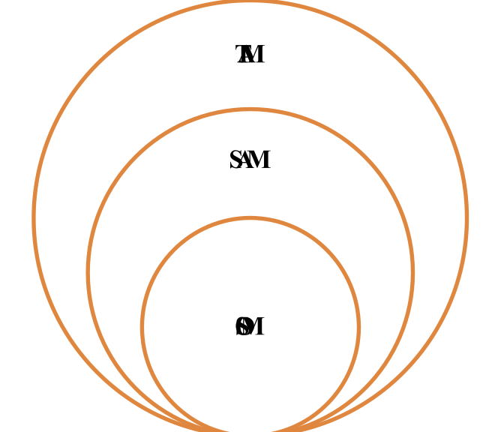
Market Size Estimation
How to calculate market size?
1.Determining Total Addressable market- 90 million Farmers.
TAM refers to the total market demand for a product or service.
If you’re entering a pre-existing space (like small business banking) you can research it and provide credible sources or reference points on how you arrived at the TAM. If you’re creating a new product or space (like Slack), you can estimate the number of customers that would want your product and approximate how much you could charge them.
2.Key Considerations: Take your target market (SAM), within that TAM, which varies depending on geography and other logistical factors. Determine the penetration potential of your target market. This is the portion of the market you can reasonably compete with-30 million Farmers.
3.By conducting research with existing competitors, distributors etc., understand the likely penetration rate-5%
4. Multiply target market by penetration rate to find your market size-5%*30=1.5 million farmers.
.
Sources: ……

Slide 6
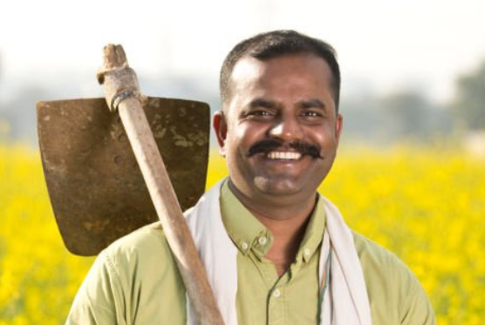
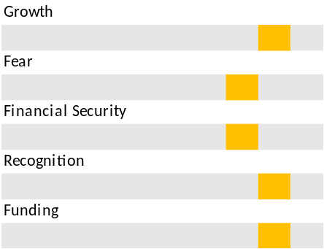
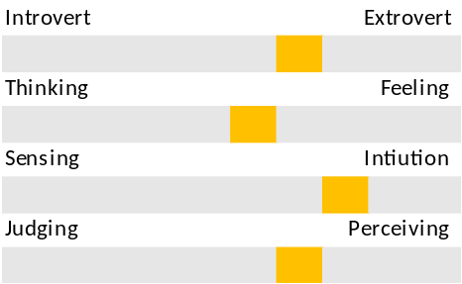
Customer Persona
Personality trait
Personality trait
Personality trait
Motivations
Goals
Quick Disease Diagnosis: Wants instant and accurate leaf disease detection
Cost-Effective Solutions: Prefers affordable and locally available treatments
Higher Yield & Profitability: Aims to maximize crop output and income
Easy-to-Use Technology: Needs a simple mobile app with regional language support
Ravi Kumar
Frustrations
Leaf Diseases: Struggles with identifying and treating crop diseases
Limited Access to Experts: Relies on neighbors or local shopkeepers for advice
Wasted Investment: Spends money on incorrect pesticides and fertilizers
Yield Uncertainty: Loss of productivity due to poor disease management
Tech Hesitancy: Uses a smartphone but is unfamiliar with advanced agri-tech solutions
Age: 45
Occupation: Farmer
Location: Andhra Pradesh, India
Personality
Bio
Ravi Kumar is a 38-year-old smallholder farmer from Andhra Pradesh, India, who owns a 2-acre farm where he primarily cultivates tomatoes and chilies. With limited access to expert agricultural guidance, he often struggles with identifying and treating leaf diseases, leading to frequent crop losses and wasted investments in ineffective pesticides. Relying mostly on advice from neighbors and local shopkeepers, he faces uncertainty in managing his yield efficiently.
Notes:
Time: 7 mins
Get students to brainstorm on the customer persona and VPC

Slide 7
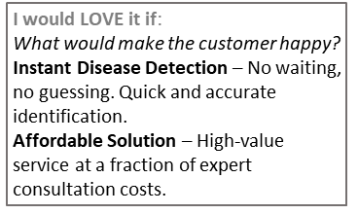
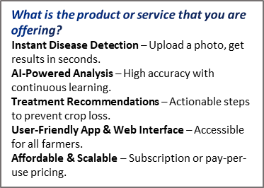
Value Proposition Canvas
What do you offer that makes the customers happy?
Accurate & Fast Disease Detection
Easy-to-Use Mobile & Web App
Actionable Solutions & Recommendations
Increased Crop Yield & Profits
Affordable Pricing & Flexible Plans
Works for Multiple Crops & Regions
Continuous Improvement & AI Learning
.
FIT
I would WANT:
What do the clients do (actions) when facing the problem?
Guess & Experiment – Try random treatments based on past experiences or suggestions.
Consult Local Experts – Seek advice from nearby farmers or agronomists, which may be limited.
GAIN CREATORS
GAINS
PRODUCT/
SERVICE
JOBS
PAIN KILLERS
PAINS
I would HATE it if:
What are the pains of the clients when facing the problem?
Uncertainty & Guesswork – Farmers struggle to diagnose crop diseases accurately.
Financial Loss – Wasted money on incorrect pesticides, treatments, and lower yields.
Time Consumption – Delays in finding the right solution lead to worsening conditions.
Which features of your offering relieve the customer's pains?
Unidentified Crop Diseases → AI-Powered Leaf Analysis:Farmers struggle to diagnose diseases early. Your AI system provides instant identification, reducing uncertainty and crop loss.

Slide 8

Solution
Place your logo here
Describe your Solution:
Develop an AI-powered mobile app that uses image recognition to detect diseases from photos of plant leaves. The app can then provide recommendations for treatment based on the analysis.
List the Benefits of Your solutions
Early Disease Detection: The AI can recognize diseases early, allowing farmers to act before significant damage occurs.
Instant Diagnosis: Provides real-time feedback and quick identification of diseases from images, saving time.
Cost-Effective: Saves money by reducing the need for unnecessary pesticide applications and manual inspections.
User-Friendly: Easy to use for farmers of all tech levels, increasing adoption.
Scalability: Suitable for both small-scale gardeners and large agricultural enterprises.
Notes:
Evaluation Criteria for slides 8 and 9
Check the following on the correctness of VPC:
a. Have you identified the correct pains & gains; pain relievers & gain creators (2 marks)
b. Have you identified the correct Jobs-to-be-done? (1 mark)
c. Are the pain relievers addressing the customer pains? (1 mark)
d. Have you identified the right value proposition so that the solution makes the customer's life better? (1 mark)

Slide 9

Competition Analysis
Benefits | Competitor 1 | Competitor 2 | Competitor 3 | Competitor 4 | Your Venture
Product | Eurofins Agroscience Services | Fermata | Plant Disease Diagnostic (PlantDiag) Platform | GoMicro | LeafVive
Price | Paid service | No fertilizer Suggestions | Free with premium features | Free for farmers | Free and open source
Branding channels | Government Website | Agri-Businesses & Farmer apps | AI research communities | WhatsApp chatbot and app | Web based
Packaging | Basic UI | Good User Interface | AI-based dashboard | WhatsApp API | User friendly ,real time analysis
Market reviews | Moderate | Good | Excellent in research | Popular among farmers | Designed specifically for Indian farmers
UVP | Government supported | Works for different soil types | AI-driven analysis | Works offline | Combines deep learning , real time weather and personalized crop suggestions
Add more as required | No fertilizer Suggestions | Include fertilizers details | Market price analysis | Language support | chatbot for farmer support.
Place your logo here

Slide 10
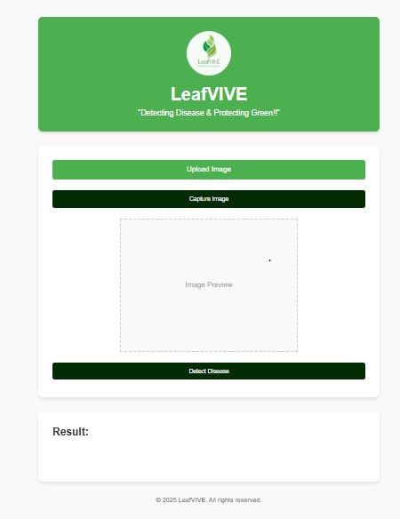
Lean Canvas
Place your logo here
PROBLEM
Plant diseases significantly impact agricultural productivity, leading to reduced crop yields and economic losses. Traditional disease detection methods rely on manual inspection, which is time-consuming, prone to errors, and requires expert knowledge.
EXISTING ALTERNATIVES
Manual Inspection by Experts
Traditional Laboratory Testing
SOLUTION
AI-Based Image Processing
Use deep learning (CNNs) to analyze leaf images and detect diseases with high accuracy.
UNIQUE VALUE PROPOSITION
Instant & Accurate Disease Detection – Advanced AI model provides real-time, high-accuracy identification of leaf diseases.
HIGH-LEVEL CONCEPT
A smart, AI-driven platform that helps farmers and agricultural businesses detect plant diseases early, reduce crop loss, and optimize treatment strategies. Using image recognition and deep learning, our system analyzes leaf images, identifies diseases with high accuracy, and provides actionable treatment recommendations
UNFAIR ADVANTAGE
Proprietary AI Model & Dataset
Offline Functionality
Localized & Crop-Specific Insights
Strong Industry & Research Partnerships
CUSTOMER SEGMENTS
Farmers & Growers-Small, medium, and large-scale farmers looking for affordable and accurate disease detection solutions.
Agricultural Cooperatives – Groups of farmers or organizations that provide shared resources and advisory services.
EARLY ADOPTERS
Tech-Savvy Farmers
Agri-Tech Enthusiasts & Startups
Agronomists & Agricultural Researchers
Business Model (Explain with a process diagram)
KEY METRICS
Accuracy
Precision & recall
F1 score
Inference time
CHANNELS
Mobile & Web Application
Agricultural Cooperatives & Farmer Group
Government & NGOs
COST STRUCTURE
The total startup cost is ₹27,00,000, covering operations, infrastructure, and initial marketing.
REVENUE STREAM
The income statement shows sales increasing with a price rise from ₹349 to ₹399 in June, while COGS grows as the cost per unit rises from ₹180 to ₹200 in May; gross profit peaks in August (₹5,37,300), fixed expenses include salaries increasing over time, marketing higher initially, and stable rent/utilities; net profit turns positive from June, with August having the highest profit (₹4,07,300).

Slide 11


MVP
Place your logo here
Provide Full product/service description
The early adopters of our Leaf Disease Detection project will be progressive farmers, agricultural cooperatives, agronomists, and agri-tech startups who recognize the importance of AI-powered disease detection in improving crop health and productivity. Tech-savvy farmers and precision agriculture enthusiasts, already using mobile apps and IoT-based solutions, will be among the first to integrate our system into their daily farming practices.
Insert a picture of the prototype
Share screenshots of website ( Landing page, testimony etc.,).
If the venture is in any online business, it must definitely showcase
a functional website.
Social media-
Instagram-@_leafvive_
Gmail-leafvive@gmail.com
Facebook-leafvive

Slide 12

MVP Validation
.
What is your MVP? Our MVP is a web app for leaf disease detection that analyzes uploaded leaf images using AI/ML to identify diseases and suggest treatments
Conclusion:
Test Details:
Persevere
How long will we test this MVP? We will test for 4 weeks.
Who is our target audience for the test? How many of them? Farmers, agronomists, and agricultural researchers – testing with 50 users.
Pivot
Not conclusive
How will we get to that audience? Social media ads, farmer community groups, agricultural events, and direct outreach to research institutions.
Results of Test:
Realizations / Insights:
Users appreciate the app’s simplicity and quick results.
Some diseases need a larger dataset for improved accuracy.
Farmers want a mobile-friendly version for easier access.
Did enough customers buy? Why or why not? Yes, 60% of targeted users tested the app due to ease of use and high interest in plant health.
Did customers pay the price we expected? Why or why not? Mostly yes, but some users reported inaccuracies for less common diseases.
Did customers come back to our product or show interest in doing so? Why or why not? 40% of users returned to test multiple leaf samples, showing strong interest.
Next Steps:
Improve AI model with a larger dataset.
Enhance treatment recommendations with expert input.
Develop a mobile version for better accessibility.
Did customers recommend our product to others or evangelize about it? Why or why not? Yes, but some suggested improvements in accuracy and a more detailed treatment guide.
Notes:
Evaluation Criteria for slides 12 to 14
Check the following on MVP?
1. Does it look credible and showcasable? Add a picture/video of the MVP? (3 marks)
2. Have you validated the product benefits and the price with real customers? Add the MVP interview records in a Google drive and add to the PPT. (1 + 1 marks)

Slide 13
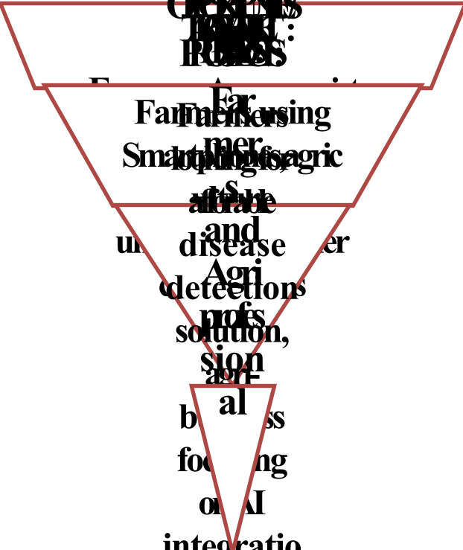
Sales Plan
Place your logo here
Customer Sales Funnel
Customer Acquisition Plan
1 | 2 | 3 | 4 | 5
Target Customer Segment (Type) | Target Customer Segment (Number) | Channels to be used to attract the target customer segment | Estimated number of leads | Estimated cost to convert these leads to actual customers
Small-scale farmers | 500 | Social media ads, farmer community groups, agri-tech forums | 300 | ₹50,000
Agronomists & researchers | 200 | University collaborations, research events, LinkedIn outreach | 100 | ₹30,000
Agri-tech companies | 50 | Cold emails, business networking, partnerships | 30 | ₹20,000
Notes:
Evaluation Criteria for slide 20 to 22
1. Does the venture have a Sales projections sheet with monthly sales targets and customer funnel defined for the next one year? (2 marks)
2. Does the venture have an active social media presence, such as FB, Instagram, LinkedIn? (1 mark)
3. Do you have a well-thought out brand name, logo, and a Positioning statement? (1 mark)
4. Have you made an actual sale? (1 mark)

Slide 14
Go-to-Market Strategy
Place your logo here
OUR LOGIN PAGE : http://localhost:5173/
OUR INSTAGRAM ACCOUNT: https://www.instagram.com/leafvive?igsh=MW40dHlnY21uc3lkaA==
Action Plan to Reach Sales/Customer Target in the Next Year
1. Defined Goals
Customer Acquisition: Increase the number of active users by 50%.
Customer Retention: Improve user retention rate by 30%.
Revenue Growth: Boost revenue by 55% through premium features and partnerships.
2. Market Analysis
Target Audience:
  Farmers, agronomists, and agricultural researchers.
  Agritech startups and government agricultural bodies.
  Hobby gardeners looking for plant disease diagnosis.
Competitor Analysis:
  Study existing plant disease detection apps and highlight accuracy, ease of use, and AI capabilities as key differentiators.
Market Trends:
  Leverage AI advancements in agriculture.
  Adapt to the growing demand for precision farming tools.
3. Product Development & Optimization
Enhanced AI Model: Improve detection accuracy for more plant species.
User-Friendly Design: Simplify the UI for non-tech-savvy farmers.
Data & Insights: Offer in-depth reports and personalized disease prevention tips.
Localization: Support multiple languages for broader adoption.
Notes:
My First Template

Slide 15
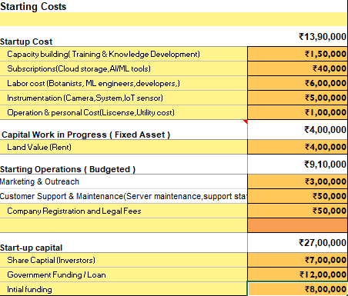
FINANCIAL PLAN
Start-up Costs
Place your logo here
Explanation:
The total startup cost is ₹27,00,000, covering operations, infrastructure, and initial marketing. Funding is sourced from investors, government loans, and initial funding, ensuring smooth business launch and sustainability.
Notes:
Evaluation Criteria for slide 24
1. Have you done their Unit Economics and come up with CAC, CLV, ARPU, Net and Gross Profit? (1 mark)
2. Do you have a plan on how to reduce their CAC and churn rate, and increase their CLV, ARPU, and Net Profit Margin? (2 marks)
3. Is the capital asked for as per the Funding plan in line with the business? (1 mark)
4. How long will it take you to return the investment? (1 mark)

Slide 16
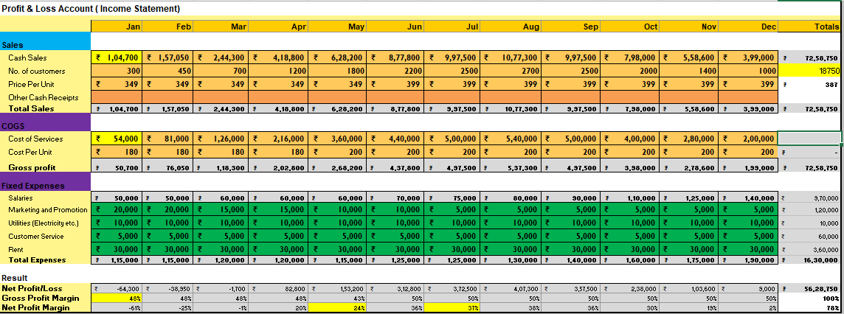
Forecast P&L
Place your logo here
Explanation:
The income statement shows sales increasing with a price rise from ₹349 to ₹399 in June, while COGS grows as the cost per unit rises from ₹180 to ₹200 in May; gross profit peaks in August (₹5,37,300), fixed expenses include salaries increasing over time, marketing higher initially, and stable rent/utilities; net profit turns positive from June, with August having the highest profit (₹4,07,300).
FOP - Financial Plan workingTemplate.xlsx
Notes:
Evaluation Criteria for slide 24
1. Have you done their Unit Economics and come up with CAC, CLV, ARPU, Net and Gross Profit? (1 mark)
2. Do you have a plan on how to reduce their CAC and churn rate, and increase their CLV, ARPU, and Net Profit Margin? (2 marks)
3. Is the capital asked for as per the Funding plan in line with the business? (1 mark)
4. How long will it take you to return the investment? (1 mark)

Slide 17
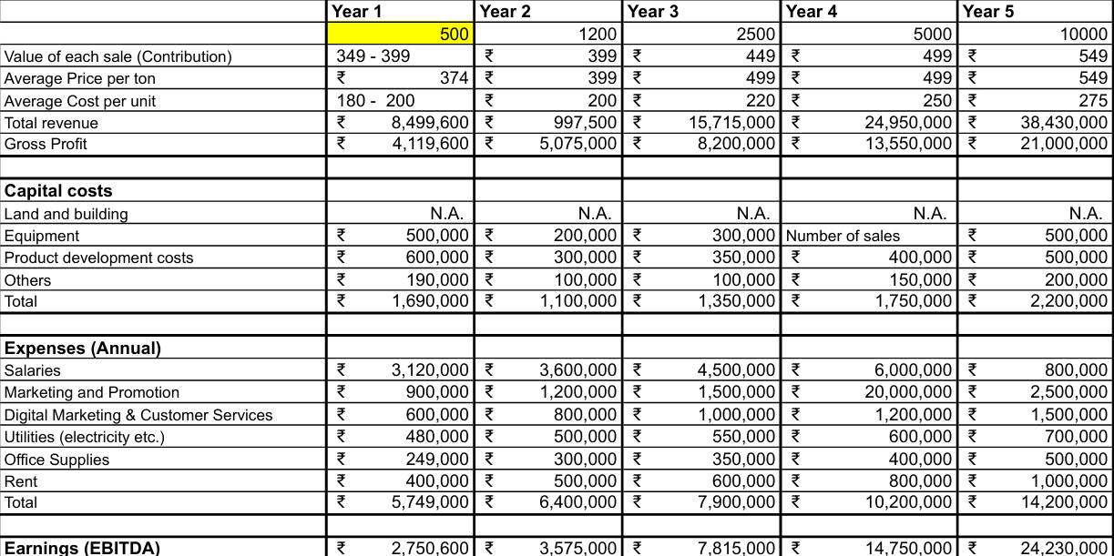
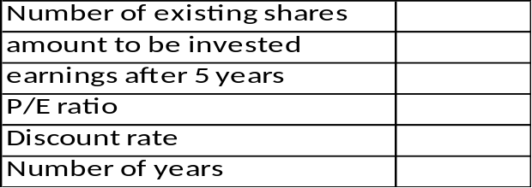
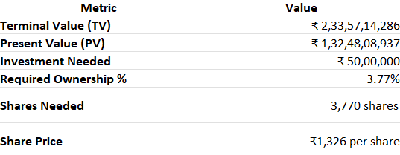
Financial Projections
Place your logo here
1,00,000
₹27,00,000
₹35,00,000
15x
10%
5 years
Notes:
Evaluation Criteria for slide 24
1. Have you done their Unit Economics and come up with CAC, CLV, ARPU, Net and Gross Profit? (1 mark)
2. Do you have a plan on how to reduce their CAC and churn rate, and increase their CLV, ARPU, and Net Profit Margin? (2 marks)
3. Is the capital asked for as per the Funding plan in line with the business? (1 mark)
4. How long will it take you to return the investment? (1 mark)

Slide 18
Unit Economics
P & L/ unit | Year …..
Revenue | ₹2,500
COGS | ₹1,200
Gross Profit | ₹1,300
Gross Profit Margin | 52%
Operating Costs | ₹500
Operating Profit | ₹800
Unit Economics | Year ……..
CAC | ₹500
CLV | ₹5,000
ARPU | ₹1,200
The above is the Unit Economics for year 1 (year ……). Refer to P&L statement for year 1 in slide 16.
​Terms | Explanation (For the actual calculations, refer to the Financial Plan Excel sheet link)​
CAC​ | (Cost of Sales + Cost of Marketing ) / Number of new customers acquired (in currency terms)​
CLV | Average purchase value x Average purchase frequency x Average Customer Lifespan x Gross Margin
ARPU​ | Total revenue in specific period/Total number of customers during the same period (in currency terms)​
GROSS PROFIT​ | Total revenue – Total COGS (In currency terms)​
OPERATING COSTS | Cost of goods sold (COGS) + operating expenses (OPEX)
OPERATING PROFIT | Revenue from Core Operations – Cost of Goods Sold – Operating Expenses – Depreciation – Amortization Expenses
CHURN RATE | (Customers at the beginning of the period – customers at the end of the period) / customers at the beginning of the period
Assumptions (Year……..)
₹500 per new customer
₹5,000 per customer
₹1,200 per customer per year
40%
₹2,00,000 annually
₹80,000 after deducting all costs
10%

Slide 19
Funding Plan
Place your logo here
How much funds required to reach to the next level of the venture?
₹20 lakh for scaling operations and marketing
How much have been bootstrapped? If not, why ?
₹5 lakh from personal savings and initial revenues.
How much can be bootstrapped?
₹3 lakh more from internal cash flow.
How much external funding required? If not, why?
₹12 lakh to cover expansion and technology upgrades.
Funds utilization strategy (Details)
Operations & Team Expansion: ₹3 lakh for hiring and infrastructure setup.
Technology Development: ₹5 lakh for AI model improvement and app enhancement.
R&D & Data Collection: ₹2 lakh for testing and improving disease detection accuracy.
Miscellaneous & Contingency: ₹1 lakh for unforeseen expenses and scalability.
Marketing & Customer Acquisition: ₹4 lakh for ads, promotions, and partnerships
Notes:
Evaluation Criteria for slide 19
1. Have you identified how much fund you need to reach the next level for the venture? (1 mark)
2. Have you bootsrapped any money till now? How much can they bootstrap?(1 mark)
3. Do you need external funding? Why or why not? (1 mark)
4. Can you explain clearly how you will utilize the money tomorrow if they get the funding today? (2 marks)

Slide 20
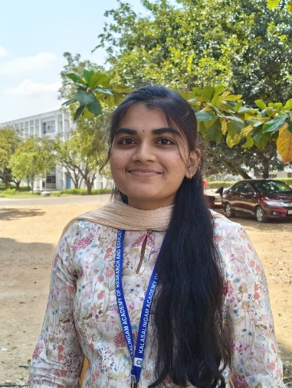
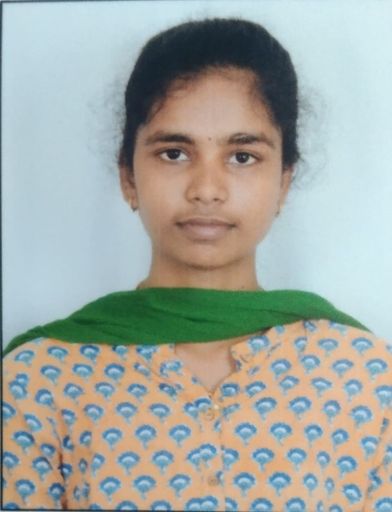
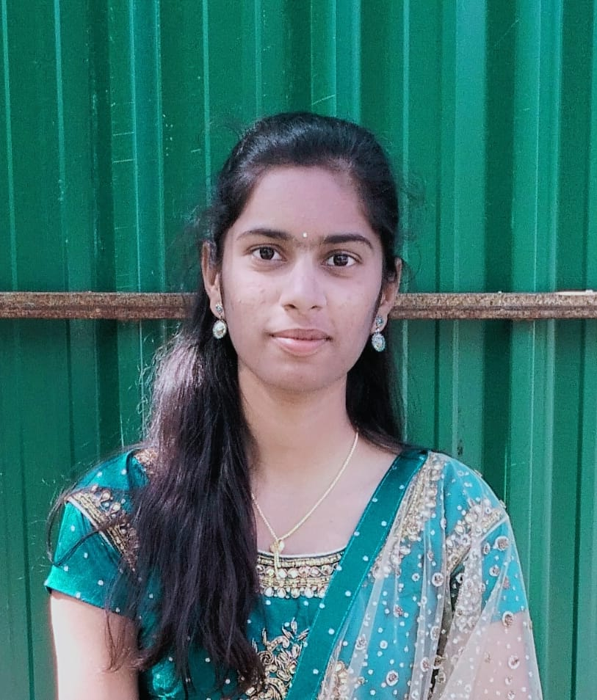
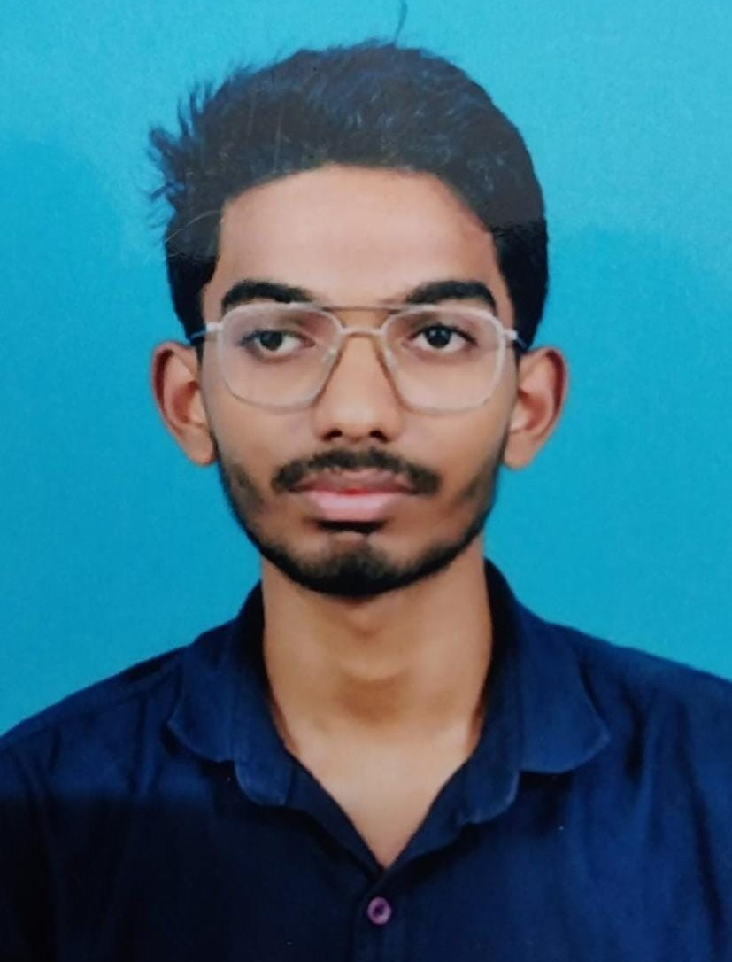
Team Composition
Team member 1
Team member 2
Team member 3
Team member 5
What makes us a good team to solve the problem we chose?
Our team is well-positioned to solve the leaf disease detection problem due to a combination of expertise, technological skills, and a deep understanding of agricultural challenges.
With backgrounds in machine learning, computer vision, and AI, our team can develop an advanced image recognition model capable of detecting plant diseases with high accuracy.
Picture
Picture
Picture
Role/Position:
CEO
Role/Position:
COO/CTO
Role/Position:
CFO/CMO
Role/Position:
CIO
Key Strengths and abilities
Technical Expertise – AI/ML, web/app development, cloud computing
Key Strengths and abilities
Market & Outreach Strategy – Connecting with farmers and industry stakeholders
Key Strengths and abilities :
Domain Knowledge – Expertise in plant diseases and agriculture
Key Strengths and abilities :
Future-Ready Development – Adopting emerging technologies to stay ahead in innovation.

Slide 21

Thank You!

